Slide 1
Chemical Kinetics
Collision Theory
Energy Diagrams
Using Table I

Slide 2
Collision Theory
When elements react with each other, you all know that it only involves the valence electrons. These outer most electrons can be shared in a Covalent Bond or they can be transferred in an Ionic Bond. This was all discussed earlier in the year.
But to get this to happen these electron must come in physical contact with each other. Collision theory is about how elements bump into each other.
Collision Theory says that for two elements to react the elements must bump into each other with enough speed and at just the right angle to allow the valance electron to interact.
If there isn’t enough speed or the angle is wrong, they will just bounce off each other and not combine.

Slide 3
So what factor affect how elements react ?
1. Temperature - Temperature is measuring the Average Kinetic Energy of a material.
Low Temperature = Elements moving at a slow speed with less kinetic energy
High Temperature = Elements moving at a high speed with more kinetic energy
So by heating a reaction up you increase the speed and energy of the collision of atoms.
2. Concentration – The more atoms there are in a container the great the chance they will collide and react.
My analogy here is there is a better chance to have a car accident if you are driving fast in a crowded parking lot then driving slow in an empty one.
3. Orientation – The two elements must collide at just the right angle for the valance electrons to interact.
Temperature and Concentration both affect this, as the atoms get hotter, their speed increases, and as there are more of them, there are more collisions and the odd increase that they will hit at the right angle to react more often.

Slide 4
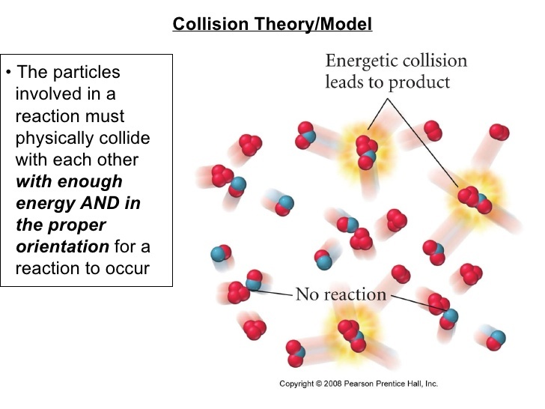

Slide 5
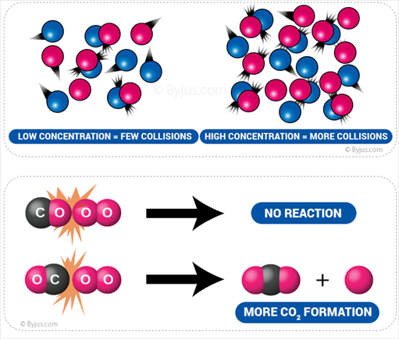
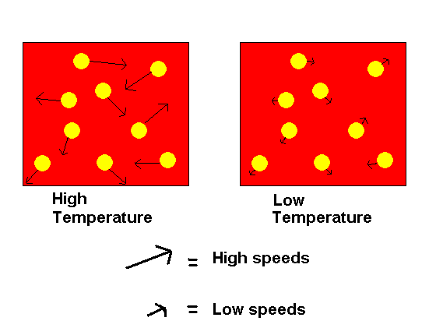
Collision Theory

Slide 6
Potential Energy Diagrams
There are two types of Energy Diagrams :
Exothermic - showing the release of energy – The react vessel will feel hot
Endothermic – Showing the absorption of energy – the reaction vessel will feel cold
The Heat of Reaction is the difference between the energy of the products minus the energy of the reactants.
The Heat of Reaction is Δ H An Exothermic reaction has a – ΔH and an Endothermic reaction has a + ΔH

Slide 7
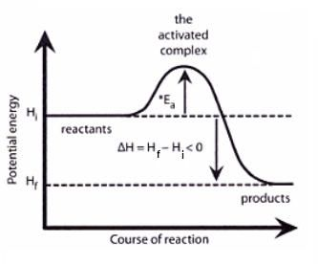
Energy Diagram - Exothermic
Activation Energy

Slide 8
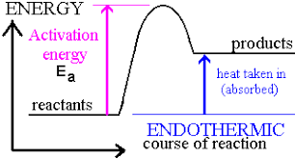
Energy Diagram - Endothermic

Slide 9
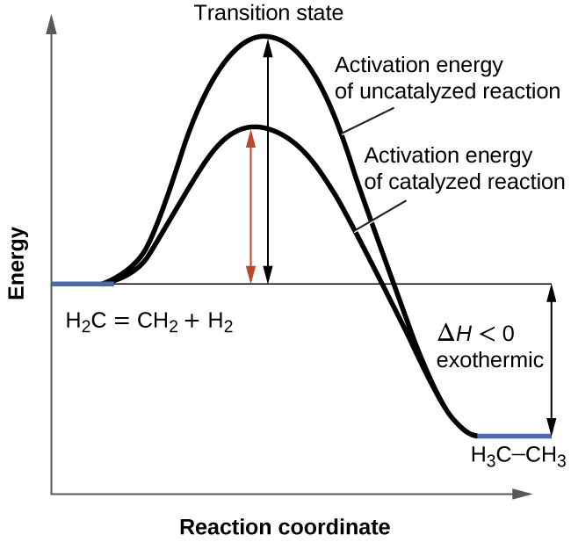
Catalyzed Reaction – A Catalyst is a chemical that lowers the activation energy of the reaction and speeds up a reaction but doesn’t become part of the reaction.

Slide 10
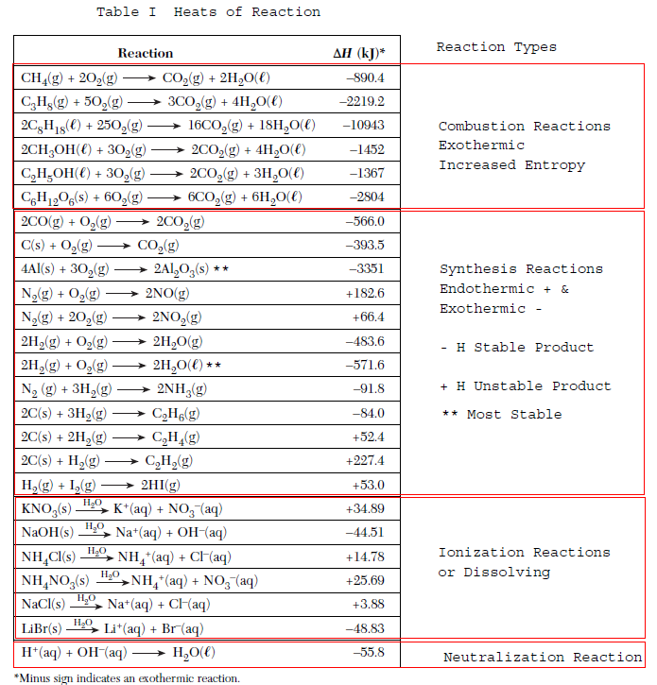
Table I - The heat of reaction table for select reactions.

Slide 11
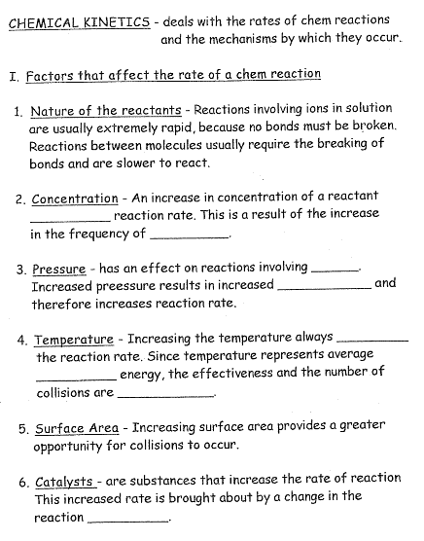

Slide 12
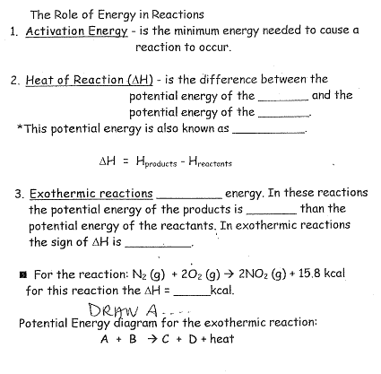

Slide 13
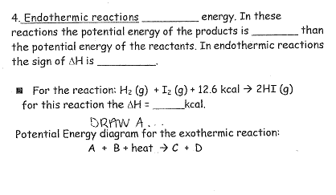

Slide 14
